Slide 1


Alphabet Soup
PPP / EIDL / ERC
Webinar – April 7, 2020

Slide 2

The information on this webinar is general information and should not be viewed as applicable to your individual situation and/or circumstance. We recommend that if you have questions on your individual situation that you follow up with either your attorney or specific accountant.
Please also understand that the information that we are providing is extremely fluid, is changing on a daily basis, and often getting superseded. What we present here today may very likely be irrelevant or incorrect tomorrow. As such, please know that it is only accurate as of today (certainly not going forward) and that even as of today the information is only our best understanding based on how we have reviewed/interpreted the information.

Slide 3
General Update
Recovery Rebate Credit
Business Incentive Roll Out
Unemployment
Emergency Family/Sick Leave

Slide 4


Slide 5


Business Incentives
PPP
EIDL
ERC
Unemployment
Payroll Tax
Holiday

Slide 6

Business

Slide 7
PPP
EIDL + ERC + Unemployment
Currently Working
(Essential Service)
High Average Wage
Enterprise Operation (Larger Payroll)
No Employees (Think Real Estate)
Summer Seasonal
High Turnover
Lower Average Wages
Lower Benefits
Smaller Number of Employees

Slide 8
Payroll Protection Program – Intent of Program
Not really for the business – For the Employee
Benefit for unemployment agency
GOAL is to get employees back on payroll (even if it doesn’t make sense to)
(i.e. at home due to Stay Safe Stay Home Order)
Maintains “Same As Usual for Employees”

Slide 9
Payroll Protection Program – How to Calculate
Your Bank is the end say on guidance used
GROSS Wages + Employer Health + Employer Retirement + Employer State

Slide 10
Payroll Protection Program

Slide 11
Payroll Protection Program – How to Calculate
Wages
Gross Wages (Don’t use Net Pay)
Don’t need to back off employer taxes – Assuming you don’t start with it
Cap of the $100,000 per employee
12 Months Ended December 31, 2019 or 12 Months ended March 31, 2020
Seasonal Calculation – February 15 – June 30, 2019

Slide 12

Payroll Protection Program – How to Calculate
Employer Retirement
Is Employer portion (not employee contributions)
Can include Profit sharing (annualized)
Most banks are limiting under the per employee cap

Slide 13
Payroll Protection Program – How to Calculate
Employer Retirement
Is Employer portion (not employee contributions)
Can include Profit sharing (annualized)
UPDATED - Employee cap is only on the cash wages, not non cash benefits

Slide 14
Payroll Protection Program – How to Calculate
Employer Health
Need to back out employee portion paid
Most Banks are asking for monthly and employee level detail
Includes costs provided under a qualifying health plan

Slide 15
Payroll Protection Program

Slide 16
Payroll Protection Program – Know Uses
Loan First – Forgiven Later
For Forgiveness:
At Least 75% for Qualifying Wages 8 Weeks after Loan Funding
Up to 25% for other allowable costs
Not All or Nothing

Slide 17
Payroll Protection Program

Slide 18
Payroll Protection Program

Slide 19
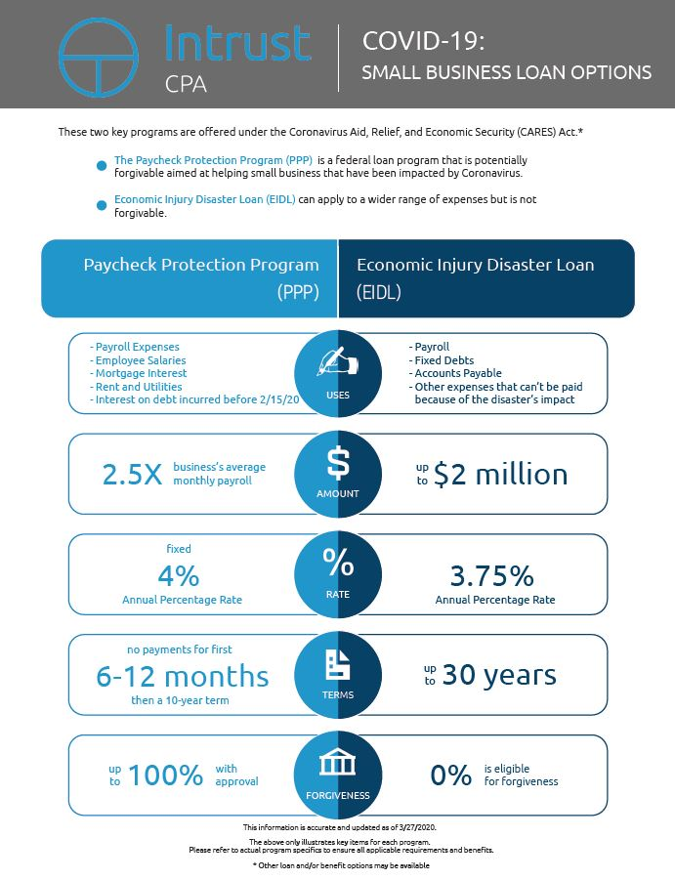

Slide 20
Economic Injury Disaster Loan
Everyone assumes the forgivable loan is the best – but having the potential to have a larger loan (albeit repayable) may be the right fit
Standing in Line – program details aren’t out yet. Are applying to get more information
Confusion related to interplay with the PPP

Slide 21
Business – Economic Injury Disaster Grant
    Grant of $10k is available
      $10,000 quick cash advance on an EIDL (within 3 days)
      Will not need to repay the advance even if denied an EIDL
      Must have been in operation on 1/31/20

Slide 22
Business – Employee Retention Credit
    Not available to recipients of paycheck protection program loans
    Refundable payroll tax credit of 50% of first $10k of compensation (+ health benefits) paid during COVID crisis between 3/13/20 and 12/31/20 (effectively an Up To $5,000 per “employee”)
    Applies to employers whose:
      Operations fully or partially suspended due to COVID related shut down order, or
      Gross receipts declined by more than 50% when compared to same quarter in previous year
      All qualifying wages for an employer with less than 100 FTE for 2019
    Wages do not include those paid out for ES&FL

Slide 23
Business – Employee Retention Credit

Slide 24
Business – Adding The Pile Up
  EIDL - $10,000
  Employee Retention Credit - $73,900
  Unemployment – $0
  Combined $83,900 –
  Compared with $133,477

Slide 25
Business – Adding The Pile Up
  EIDL - $10,000
  Employee Retention Credit - $73,900
  Unemployment – $55,920 (4 weeks)
  Combined 139,820 – Employer Benefit
  Compared with $133,477

Slide 26
Business – Adding The Pile Up
  What if the Stay Home Stay Safe goes longer?
  Employee feeling they would rather be on unemployment
  No limit on how the Employee Retention Credit is used

Slide 28
Business – One More Example
  EIDL - $10,000
  Employee Retention Credit - $10,000 (2 Employees @ $36,000 each)
  Unemployment – $0
  Combined $20,000
  Compared with $15,000

Slide 29
Business – One More Example
  EIDL - $10,000
  Employee Retention Credit - $0
  Unemployment – $0
  Combined $10,000
  Compared with $0

Slide 30
Unemployment
SOM – Self Employed Still not available
State stilling figuring out how to work through the CARES Act
State benefit ($362 max + $600)

Slide 31
Looking Ahead
We are going to continue these seminars each Tuesday at 1PM. May be new information, may be further guidance on the key items, may be deeper dives into the programs that seem to be rising to the surface
Check our website for continued updated information
www.intrustcpa.us
www.integratedpayroll.us

Slide 32
THANK YOU

Slide 33


Slide 34


Slide 35


